Slide 1
Artificial Intelligence
Dr. O. I. Adelaiye

Slide 2
Machine Learning
Lecture 7

Slide 3


Slide 4
Introduction
We all have been using GPS navigation services.
Our current locations and velocities are being saved at a central server for managing traffic.
This data is then used to build a map of current traffic.
Machine learning in such scenarios helps to estimate the regions where congestion can be found on the basis of daily experiences.

Slide 5
Introduction
Some areas for applying machine learning
Traffic Alerts
Social Media
Transportation and Commuting
Products Recommendations
Virtual Personal Assistants
Self Driving Cars
Dynamic Pricing
Google Translate
Online Video Streaming
Fraud

Slide 6
Introduction
Here is another cool application of Machine Learning.
People are already using it.
Machine Learning used in Self Driving Cars (Tesla).
The leader in this business and their current Artificial Intelligence is driven by hardware manufacturer NVIDIA
This is based on Unsupervised Learning Algorithm.

Slide 7
What is machine Learning
Machine learning (ML) is the subset of artificial intelligence (AI)
ML focuses on building systems that learn or improve performance based on the data they consume.
Machine learning and AI are often discussed together, and the terms are sometimes used interchangeably, but they don’t mean the same thing. An important distinction is that although all machine learning is AI, not all AI is machine learning.

Slide 8
Approaches
Algorithms are the engines that power machine learning.
Two major types of machine learning algorithms are used today
Supervised learning and unsupervised learning.
The difference between them is defined by how each learns about data to make predictions.

Slide 9
Supervised Learning
Training the machine using data which is well “labelled.”
It means the data is already tagged with the correct answer.
It can be compared to learning which takes place in the presence of a supervisor or a teacher.
A supervised learning algorithm learns from labelled training data, helps you to predict outcomes for unforeseen data.

Slide 10
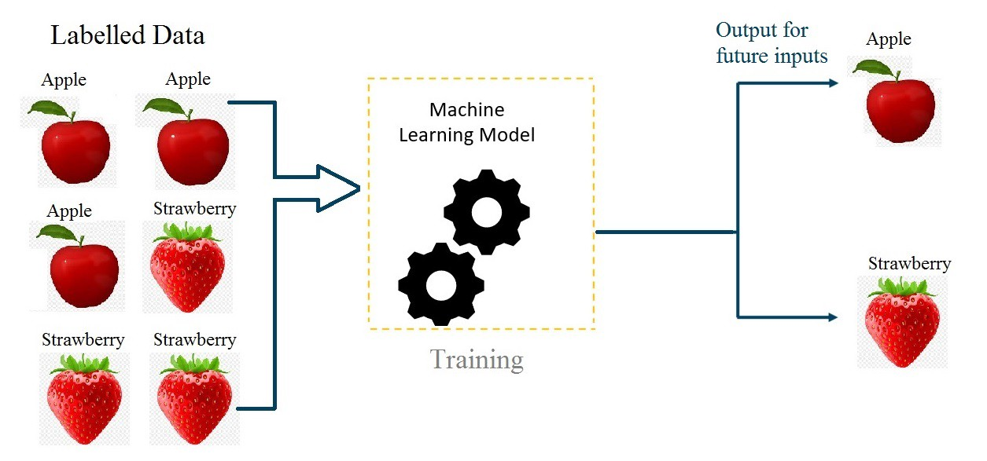

Slide 11
Why Supervised Learning
Supervised learning allows you to collect data or produce a data output from the previous experience.
Helps you to optimize performance criteria using experience
Supervised machine learning helps you to solve various types of real-world computation problems.

Slide 12
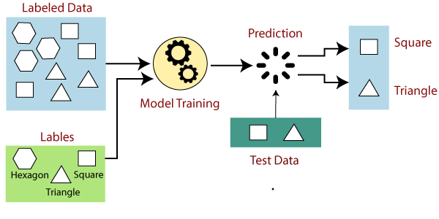
How it works

Slide 13
Types of Supervised Machine Learning Techniques
Classification:
To group the output inside a class. If the algorithm tries to label input into two distinct classes, it is called binary classification. Selecting between more than two classes is referred to as multiclass classification.
Regression:
Predicts a single output value using training data.
Example: You can use regression to predict the house price from training data. The input variables will be locality, size of a house, etc.

Slide 14
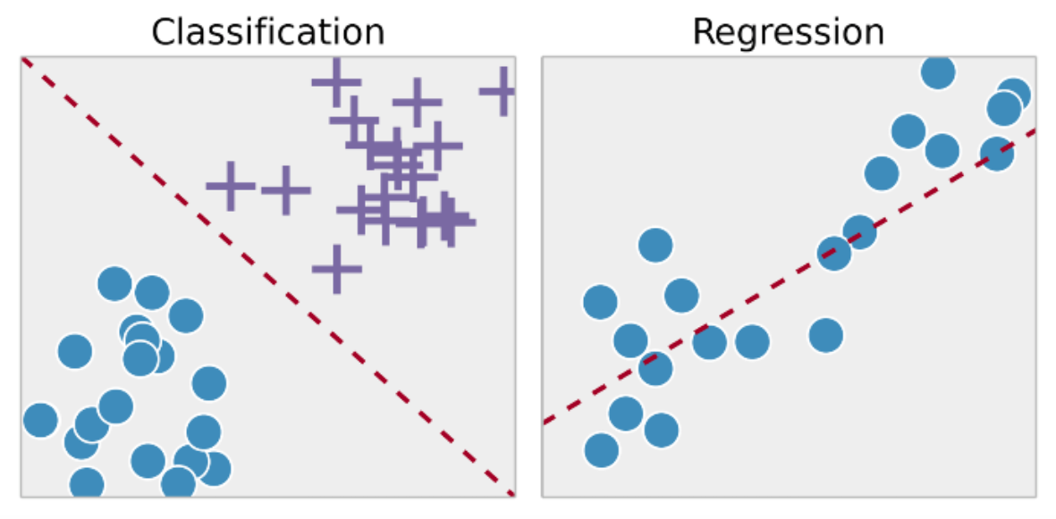
Types of Supervised Machine Learning Techniques

Slide 15
Basic steps involved in Supervised Learning
Step 1 : Defining problem and gathering data for it.
Step 2 : Pre-processing data.
Step 3 : Split data into train and test sets.
Step 4 : Training the model.
Step 5 : Evaluating model.
Step 6 : Improve model.
Step 7 : Deploying model and monitoring.

Slide 16
Unsupervised Learning
No need to supervise the model.
Instead, you need to allow the model to work on its own to discover information.
It mainly deals with the unlabelled data.
Unsupervised learning algorithms allow you to perform more complex processing tasks compared to supervised learning.

Slide 17
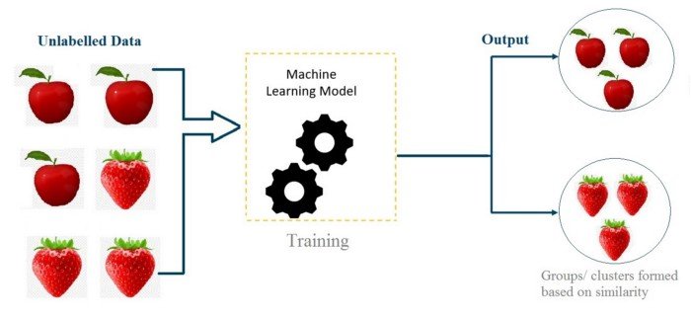

Slide 18
Why Unsupervised Learning
It finds all kind of unknown patterns in data.
It help you to find features which can be useful for categorization.
It is taken place in real time, so all the input data to be analysed and labelled in the presence of learners.
It is easier to get unlabelled data from a computer than labelled data, which needs manual intervention.

Slide 19
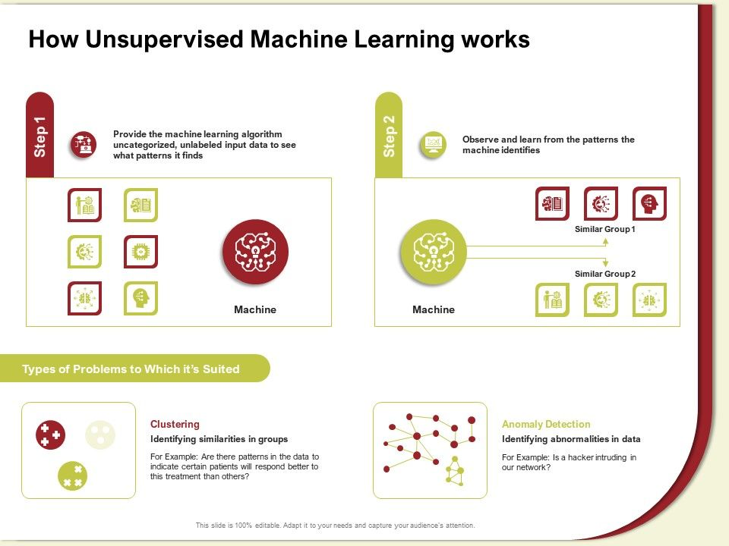

Slide 20
Types of Unsupervised Machine Learning Techniques
Clustering
Mainly deals with finding a structure or pattern in a collection of uncategorized data.
Clustering algorithms will process your data and find natural clusters (groups) if they exist in the data.
You can also modify how many clusters your algorithms should identify. It allows you to adjust the granularity of these groups.

Slide 21
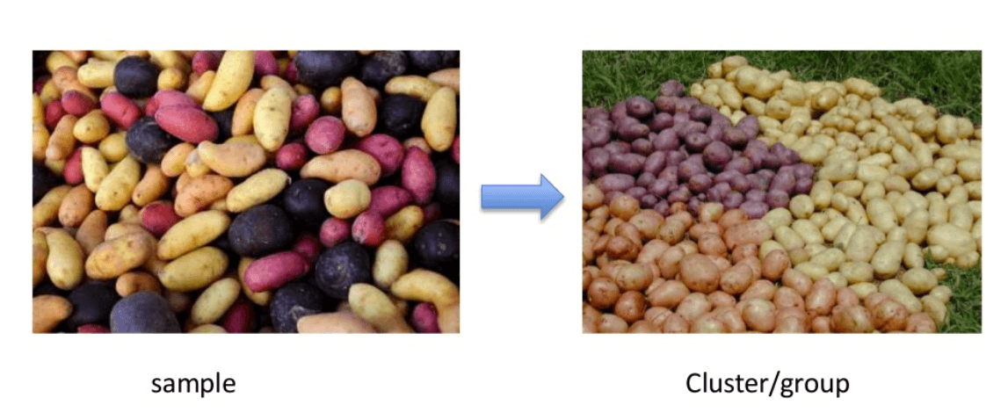
Clustering

Slide 22
Types of Unsupervised Machine Learning Techniques
Association
Association rules allow you to establish associations amongst data objects inside large databases.
It is about discovering exciting relationships between variables in large databases.
For example, people that buy a new home most likely to buy new furniture.

Slide 23
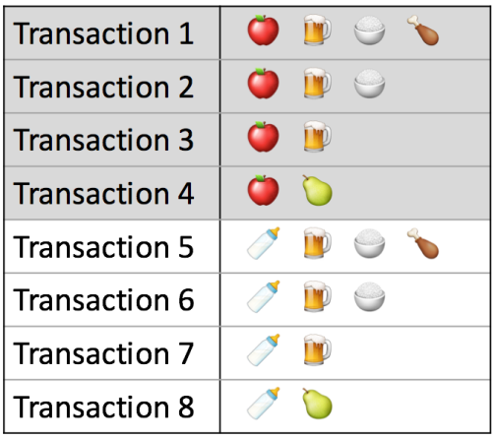
Association

Slide 24
Difference Between Supervised and Unsupervised Learning
Parameters | Supervised machine learning technique | Unsupervised machine learning technique
Process | In a supervised learning model, input and output variables will be given. | In unsupervised learning model, only input data will be given
Input Data | Algorithms are trained using labeled data. | Algorithms are used against data which is not labeled
Algorithms Used | Support vector machine, Neural network, Linear and logistics regression, random forest, and Classification trees. | Unsupervised algorithms can be divided into different categories: like Cluster algorithms, K-means, Hierarchical clustering, etc.
Computational Complexity | Supervised learning is a simpler method. | Unsupervised learning is computationally complex

Slide 25
Difference Between Supervised and Unsupervised Learning
Parameters | Supervised machine learning technique | Unsupervised machine learning technique
Use of Data | Supervised learning model uses training data to learn a link between the input and the outputs. | Unsupervised learning does not use output data.
Accuracy of Results | Highly accurate and trustworthy method. | Less accurate and trustworthy method.
Real Time Learning | Learning method takes place offline. | Learning method takes place in real time.
Number of Classes | Number of classes is known. | Number of classes is not known.
Main Drawback | Classifying big data can be a real challenge in Supervised Learning. | You cannot get precise information regarding data sorting, and the output as data used in unsupervised learning is labelled and not known.

Slide 26
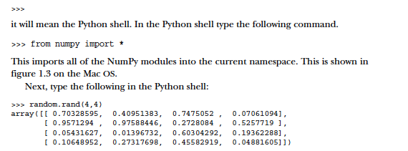
Let’s get started

Slide 27
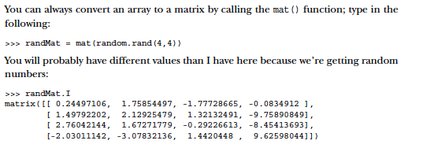
Some more

Slide 28


Slide 29
Q1
A Nigerian version of Apple’s Siri was developed. The machine was meant to interact with mobile phone users and present them with immediate answers and solutions. A user asked, “I wanna chop meat”. The machine was confused as to whether the user meant “I wanna cut meat” or I wanna eat meat”. As an AI expert, if you were presented with this problem, what will be your approach in solving it?

Slide 30
Q2
Using this text “London is the capital and most populous city of England and the United Kingdom. Standing on the River Thames in the south east of the island of Great Britain, London has been a major settlement for two millennia. It was founded by the Romans, who named it Londinium.”
As a human reading this sentence, you can easily figure out that “it” means “London”. Explain how the machine can figure this out.

Slide 31
Q3
Differentiate between syntax and semantics as it concerns knowledge representation.

